Slide 1
Revenue Models
There are various revenue models that can be implemented based on your specific business operations and needs. Understanding when and how to choose different types of revenue models will help you better calculate revenue growth rates.

Slide 2
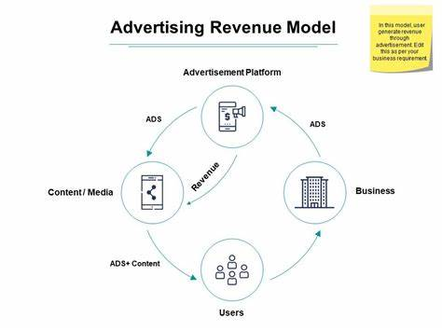
Advertising-supported Revenue model
An advertising revenue model is a popular type of revenue model. The main source of income is generated by displaying advertisements. In this model, your company sells advertising space to other businesses or brands who want to advertise with your customer base and users. How your business earns revenue is by charging advertisers for ad placements.

Slide 3
Advantages
Successful advertisement-based revenue models typically generate significant income.
An advertising model can greatly boost revenue streams if you have a large user base or a popular platform.
There's a low barrier to entry, meaning it's relatively easy to set up and requires minimal investment upfront.
This revenue model also offers flexibility and opportunities for diversification since you can provide many ad types and have a full roster of advertisers.

Slide 4
Disadvantages
Advertisers aren't guaranteed.
You need to attract advertisers who are willing to pay for placements on your platform.
The advertising market constantly fluctuates, meaning your revenue may fluctuate whenever advertisers reduce their budgets and don't buy ad space.
You must also consider user experience and how incorporating display ads will impact your engagement.

Slide 5



Example
YouTube is well-known for using an advertising model. Content creators on the platform can monetize their content by displaying ads on their videos. YouTube earns revenue by selling advertising space to companies that want to reach a vast audience. In this case, content creators can also receive a share of the ad revenue based on several metrics, including clicks, view time, and impressions.

Slide 6

Thank you

